Slide 1

KULTUREHIRE INTERNSHIP
Career Aspiration Analytics - DA
UNDERSTANDING THE CAREER ASPIRATIONS OF GENZ
PRAKUL H N
DATA ANALYTICS INTERN
KULTUREHIRE

Slide 2
STAGE I:
EXCEL DASHBOARD

Slide 3
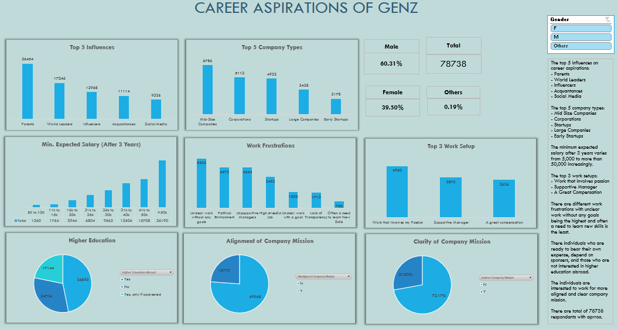

Slide 4
STAGE II:
PROBLEM STATEMENT

Slide 5
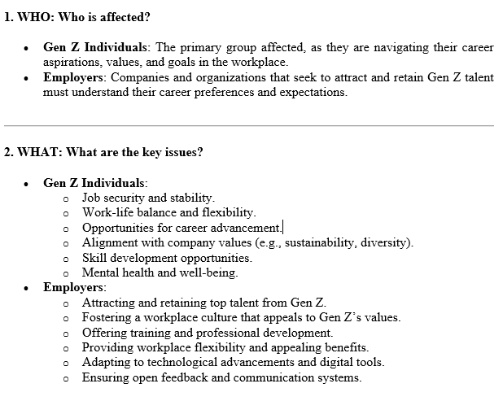
Understanding Career Aspirations of Gen Z using the 5W1H Framework

Slide 6
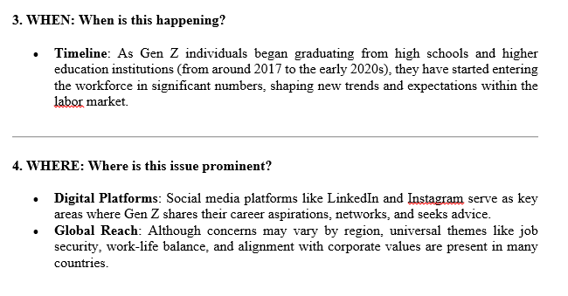
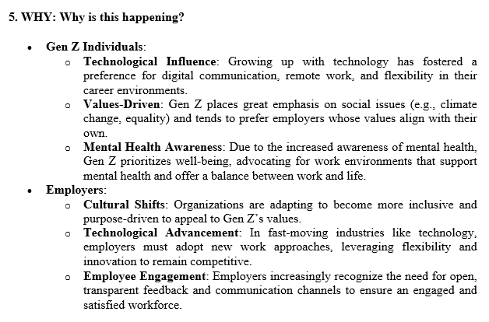

Slide 7
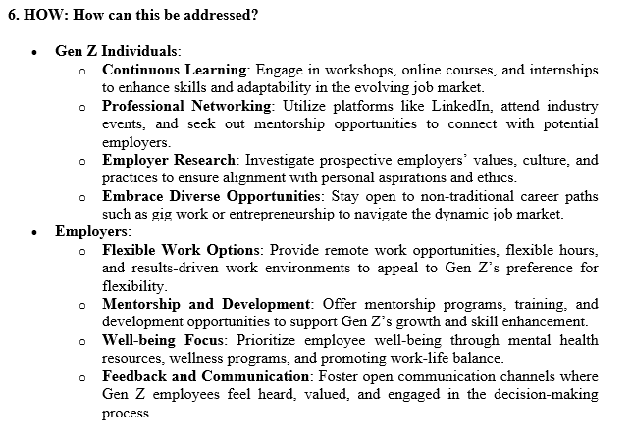

Slide 8
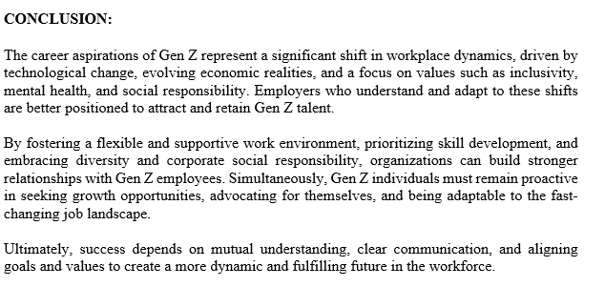

Slide 9
STAGE III:
DATA COLLECTION

Slide 10
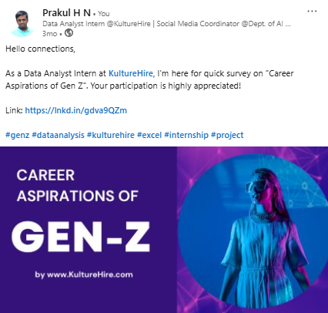

Slide 11
STAGE IV:
DATA ANALYSIS IN SQL

Slide 12
Queries Solved:
1. What is the gender distribution of respondents from India?
2. What percentage of respondents from India are interested in education abroad and sponsorship?
3. What are the 6 top influences on career aspirations for respondents in India?
4. How do career aspiration influences vary by gender in India?
5. What percentage of respondents are willing to work for a company for at least 3 years?
6. How many respondents prefer to work for socially impactful companies?
7. How does the preference for socially impactful companies vary by gender?
8. What is the distribution of minimum expected salary in the first three years among respondents?
9. What is the expected minimum monthly salary in hand?
10. What percentage of respondents prefer remote working?
11. What is the preferred number of daily work hours?
12. What are the common work frustrations among respondents?
13. How does the need for work-life balance interventions vary by gender?
14. How many respondents are willing to work under an abusive manager?
15. What is the distribution of minimum expected salary after five years?
16. What are the remote working preferences by gender?
17. What are the top work frustrations for each gender?
18. What factors boost work happiness and productivity for respondents?
19. What percentage of respondents need sponsorship for education abroad?

Slide 13
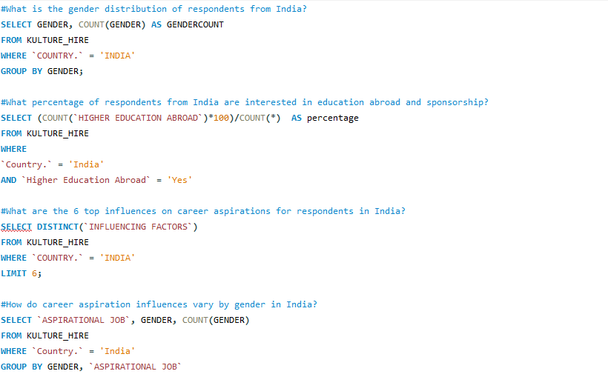

Slide 14
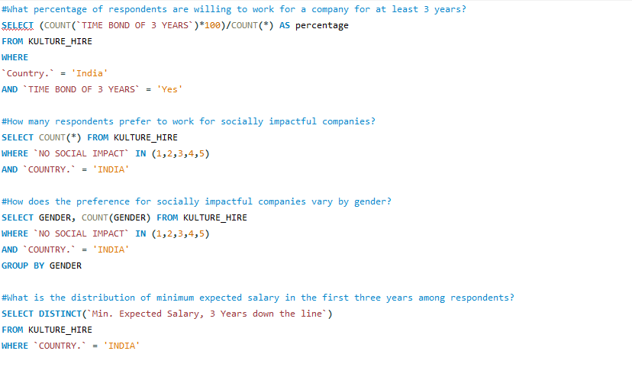

Slide 15
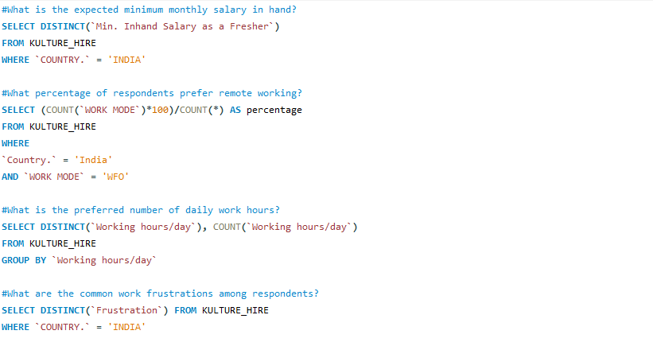

Slide 16
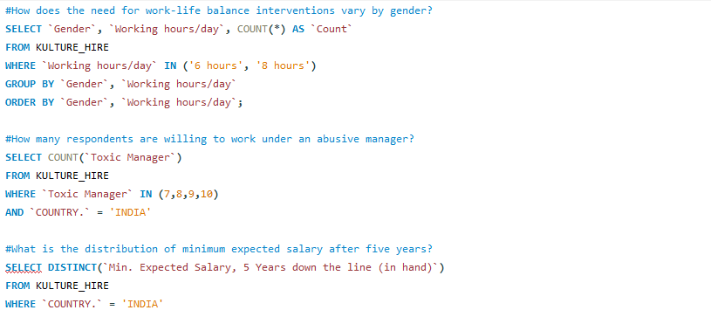

Slide 17
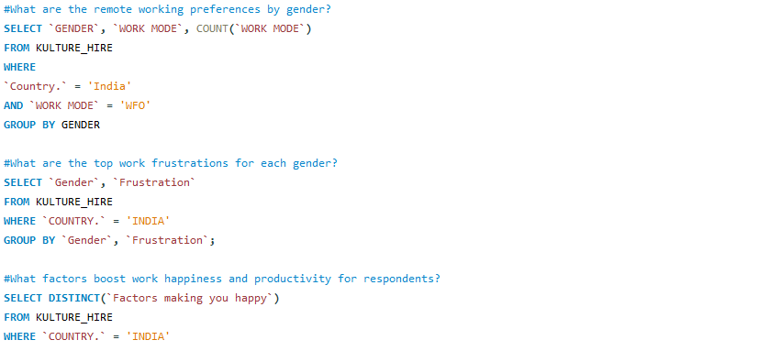

Slide 18
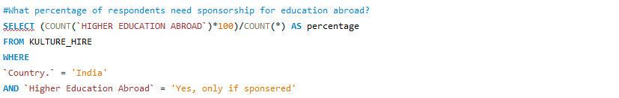

Slide 19
STAGE V:
MANAGER ASPIRATIONS DASHBOARD (POWER BI)

Slide 20
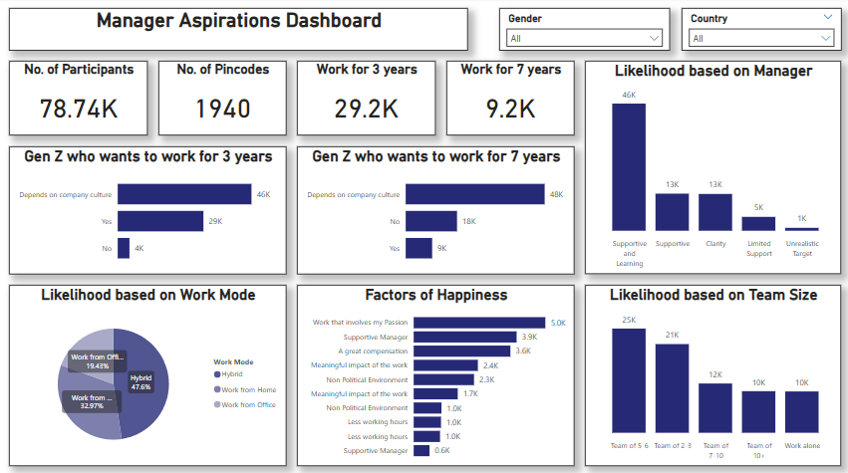

Slide 21
STAGE VI:
MISSION ASPIRATIONS DASHBOARD (POWER BI)

Slide 22
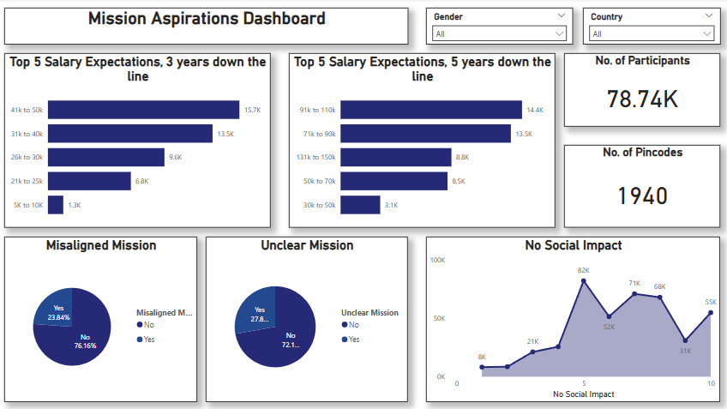

Slide 23


